Slide 1

UNIVERSITY INSTITUTE OF COMPUTING
MASTER OF COMPUTER APPLICATIONS
DESIGN AND ANALYSIS OF ALGORITHMS
UNIT-2.1
DISCOVER . LEARN . EMPOWER

Slide 2
Divide & Conquer
Divide and Conquer is an algorithm design paradigm that involves breaking up a larger problem into non-overlapping sub-problems, solving each of these sub-problems, and combining the results to solve the original problems. A problem has non-overlapping​ sub-problems if you can find its solution by solving each sub-problem once.

Slide 3
Divide & Conquer (contd.)
The three main steps in the divide and conquer paradigm are:
divide: involves breaking the problem into smaller, non-overlapping chunks.
conquer: involves solving the sub-problems recursively.
combine: involves combining the solutions of the smaller sub-problems to solve the original problem.

Slide 4
Divide-and-Conquer Technique (cont.)
a problem of size n
(instance)
subproblem 1
of size n/2
subproblem 2
of size n/2
a solution to subproblem 1
a solution to subproblem 2
It general leads to a recursive algorithm!
a solution to
the original problem
Fig. 1: Representation of Divide & Conquer

Slide 5
Divide-and-Conquer Examples
Sorting: mergesort and quicksort
Binary tree traversals
Binary search

Slide 6
Binary Search
The binary search algorithm uses the divide-and-conquer strategy to search through an array
The array must be sorted
  the “zeroing in” strategy for looking up a word in the dictionary won’t work it the words are not in alphabetical order
  binary search will not work unless the array is sorted

Slide 7
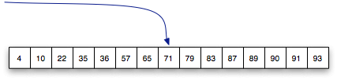


Binary Search (contd.)
To search a list of n items, first look at the item in location n/2
  then search either the region from 0 to n/2-1 or the region from n/2+1 to n-1
Example: searching for 57 in a sorted list of 15 numbers
start in the middle
③
②
①

Slide 8

Binary Search (contd.)
The algorithm uses two variables to keep track of the boundaries of the region to search
  lower the index one below the leftmost item in the region
  upper the index one above the rightmost region
initial values when searching an array of n items:
lower = -1
upper = n

Slide 9
Binary Search (contd.)
The algorithm is based on an iteration (“loop”) that keeps making the region smaller and smaller
  the initial region is the complete array
  the next one is either the upper half or lower half
  the one after that is one quarter, then one eighth, then...
initial values when searching an array of n items:
lower = -1
upper = n

Slide 10
Binary Search (contd.)
The heart of the algorithm contains these operations:
  mid = (lower + upper) / 2
  return mid if k == a[mid]
  upper = mid if k < a[mid]
  lower = mid if k > a[mid]
The first iteration when searching for 57 in a list of size 15:
*
lower = -1
upper = 15
mid = 14 / 2 = 7
upper for next iteration: 7

Slide 11
Binary Search (contd.)
The remaining iterations when searching for 57:
  lower = -1
  upper = 7
  mid = 3
  lower = 3
  lower = 3
  upper = 7
  mid = 5
  found it!
mid = (lower + upper) / 2return mid if k == a[mid]upper = mid if k < a[mid]lower = mid if k > a[mid]
[
*
]
[
*
]
This search required only 3 comparisons:
a[7], a[3], a[5]

Slide 12
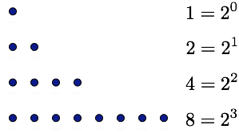
Binary Search (contd.)
The number of iterations made by this algorithm when it searches an array of n items is roughly
To see why, consider the question from the other direction
  suppose we have an array that starts out with 1 item
  suppose each step of an iteration doubles the size of the array
  after n steps we will have 2^{n} items in the array
The complexity of Binary search algorithm is O (log n)

Slide 13
Divide-and-Conquer - Advantages
Complexity can be reduced using the concepts of divide and conquer.
Increase in productivity by allowing multiple programmers to work on different parts of the project independently at the same time.
Modules can be re-used many times; thus, it saves time, reduces complexity and increase reliability.
Easier to update/fix the program by replacing individual modules rather than larger amount of code.
Ability to either eliminate or at least reduce the necessity of employing GOTO statement
Since the sub-problems are independent, they can be computed in parallel.

Slide 14
Divide and Conquer - Disadvantages
Problem decomposition may be very complex and therefore not actually suitable to divide and conquer.
Recursive nature of the solution may end up duplicating sub-problems, dynamic solutions may be better in some of these cases, like Fibonacci.
Recursion into small/tiny base cases may lead to huge recursive stacks, and efficiency can be lost by not applying solutions earlier for larger base cases.

Slide 15
Complexity
The complexity of the divide and conquer algorithm is calculated using the master theorm.
T(n) = aT(n/b) + f(n),
where,
n = size of input
a = number of subproblems in the recursion
n/b = size of each subproblem. All subproblems are assumed to have the same size.
f(n) = cost of the work done outside the recursive call, which includes the cost of dividing the problem and cost of merging the solutions.

Slide 16
Merge Sort
Merge Sort is a Divide and Conquer algorithm. It divides input array in two halves, calls itself for the two halves and then merges the two sorted halves. The merge() function is used for merging two halves. The merge(arr, l, m, r) is key process that assumes that arr[l..m] and arr[m+1..r] are sorted and merges the two sorted sub-arrays into one. See following C implementation for details.

Slide 17
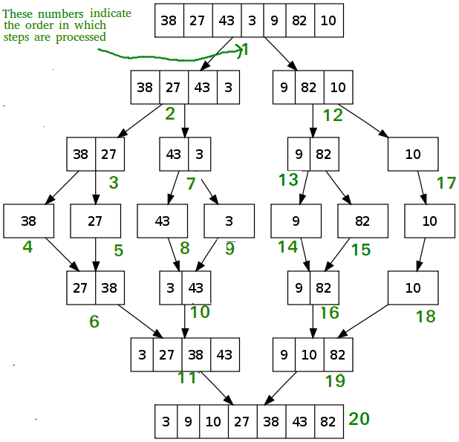
How Merge Sort Works?
Figure1: Example of Merge sort

Slide 18
Contd…
Merge sort is a sorting technique based on divide and conquer technique. With worst-case time complexity being Ο(n log n), it is one of the most respected algorithms.
Merge sort first divides the array into equal halves and then combines them in a sorted manner.

Slide 19
Contd…
To understand merge sort, we take an unsorted array as the following −
We know that merge sort first divides the whole array iteratively into equal halves unless the atomic values are achieved. We see here that an array of 8 items is divided into two arrays of size 4.

Slide 20


Contd…
Figure2: Example of Merge sort

Slide 21

Contd…
This does not change the sequence of appearance of items in the original. Now we divide these two arrays into halves.
Figure3: Merge sort
We further divide these arrays and we achieve atomic value which can no more be divided.

Slide 22
Contd…
Now, we combine them in exactly the same manner as they were broken down. Please note the color codes given to these lists.
We first compare the element for each list and then combine them into another list in a sorted manner. We see that 14 and 33 are in sorted positions. We compare 27 and 10 and in the target list of 2 values we put 10 first, followed by 27. We change the order of 19 and 35 whereas 42 and 44 are placed sequentially.

Slide 23


Contd…
Figure 4: Swapping and sorting

Slide 24
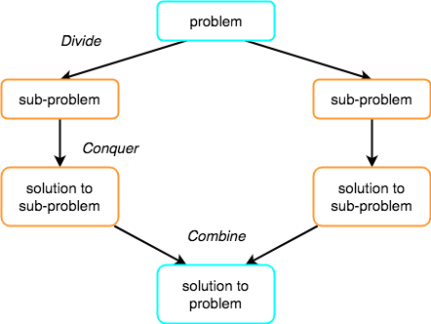
Divide, Conquer and Combine
Figure 5: Divide, conquer and Combine

Slide 25
Complexity Analysis
Worst Case Time Complexity [ Big-O ]: O(n*log n)
Best Case Time Complexity [Big-omega]: O(n*log n)
Average Time Complexity [Big-theta]: O(n*log n)
Space Complexity: O(n)
Figure 5: Divide, conquer and Combine

Slide 26
Quick Sort
Quick sort is a highly efficient sorting algorithm and is based on partitioning of array of data into smaller arrays.
A large array is partitioned into two arrays one of which holds values smaller than the specified value, say pivot, based on which the partition is made and another array holds values greater than the pivot value.
Quicksort partitions an array and then calls itself recursively twice to sort the two resulting subarrays.
This algorithm is quite efficient for large-sized data sets as its average and worst-case complexity are O(nLogn) and O(n²), respectively.

Slide 27
How Quick Sort Works?
Following are the steps involved in quick sort algorithm:
1. After selecting an element as pivot, which is the last index of the array in our case, we divide the array for the first time.
2. In quick sort, we call this partitioning. It is not simple breaking down of array into 2 subarrays, but in case of partitioning, the array elements are so positioned that all the elements smaller than the pivot will be on the left side of the pivot and all the elements greater than the pivot will be on the right side of it.
3. And the pivot element will be at its final sorted position.
4. The elements to the left and right, may not be sorted.
5. Then we pick subarrays, elements on the left of pivot and elements on the right of pivot, and we perform partitioning on them by choosing a pivot in the subarrays.

Slide 28
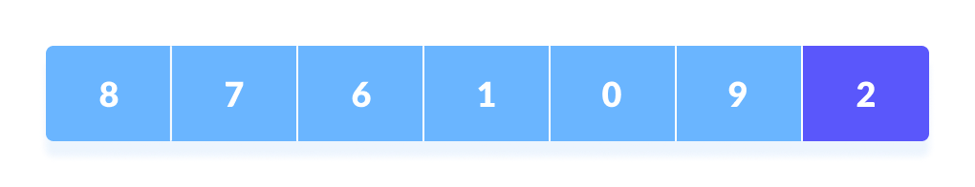
How Quick Sort Works?
1. A pivot element is chosen from the array. You can choose any element from the array as the pivot element.
Here, we have taken the rightmost (ie. the last element) of the array as the pivot element.
Figure1: Choosing Pivot element

Slide 29
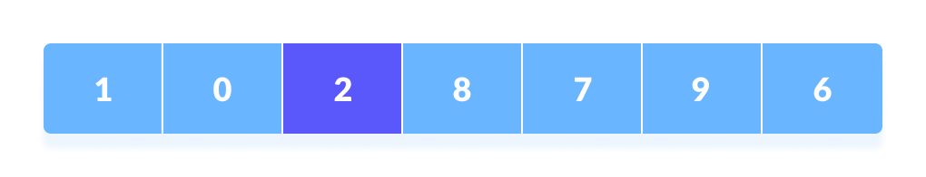
Contd…
2. The elements smaller than the pivot element are put on the left and the elements greater than the pivot element are put on the right.
Figure 2: Setting pivot element

Slide 30
Contd…
The above arrangement is achieved by the following steps.
A pointer is fixed at the pivot element. The pivot element is compared with the elements beginning from the first index. If the element greater than the pivot element is reached, a second pointer is set for that element.
Now, the pivot element is compared with the other elements (a third pointer). If an element smaller than the pivot element is reached, the smaller element is swapped with the greater element found earlier.

Slide 31
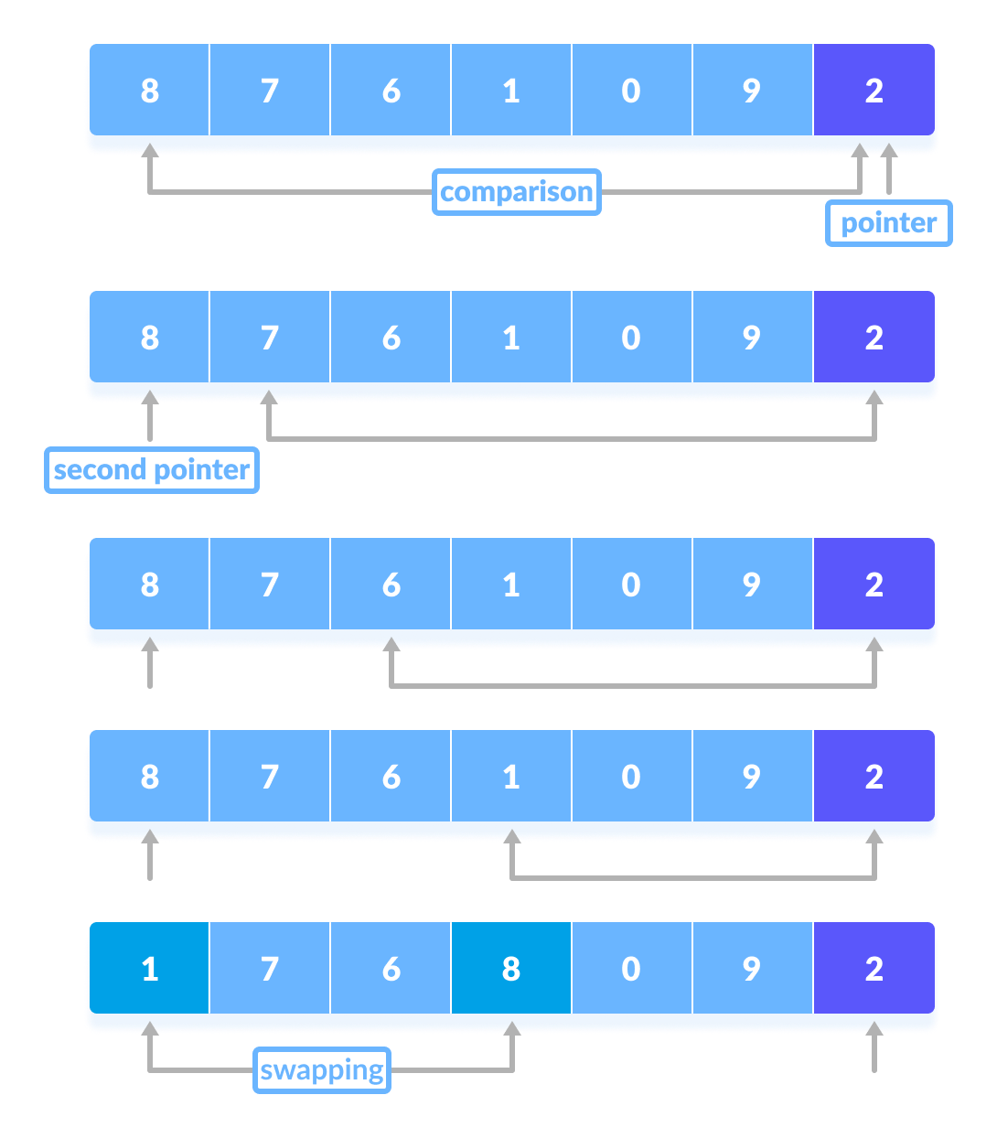
Contd…
Figure3: Swapping

Slide 32
Contd…
The process goes on until the second last element is reached.
Finally, the pivot element is swapped with the second pointer.

Slide 33
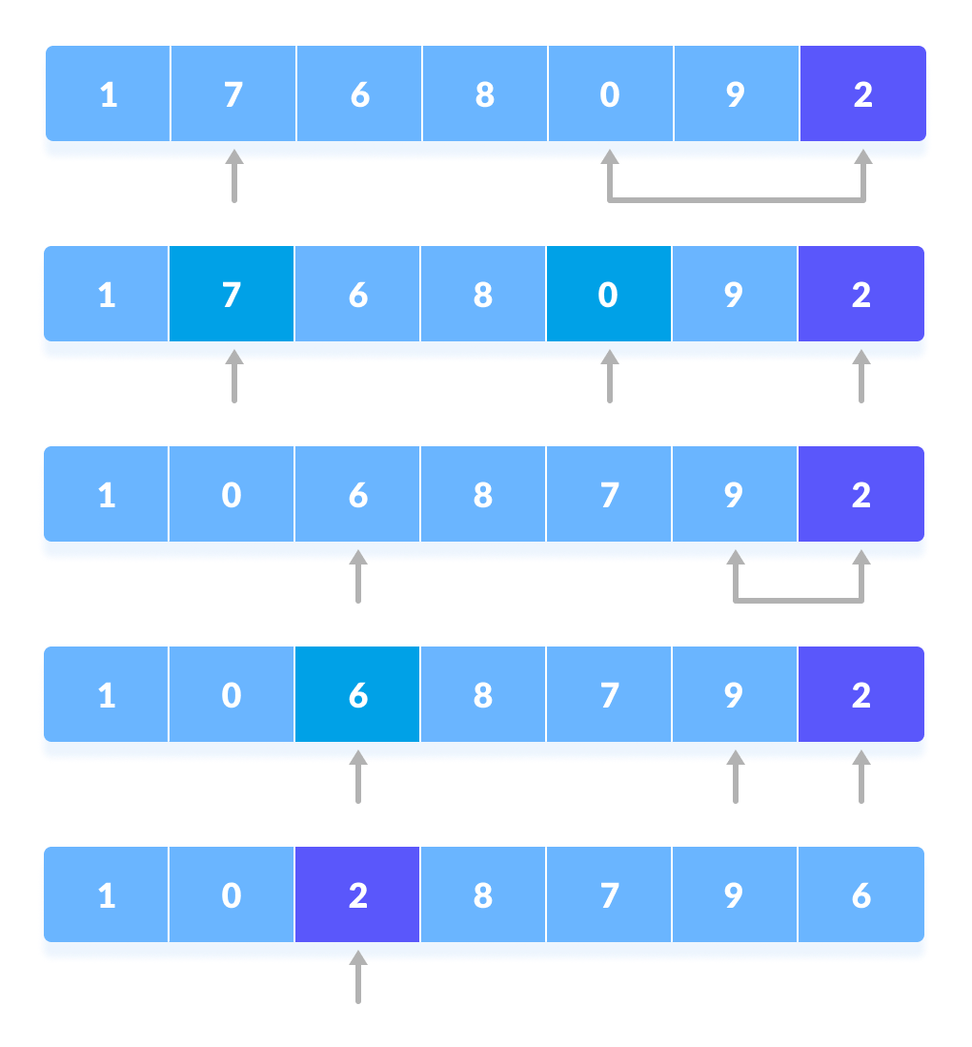
Contd…
Figure 4: Swapping

Slide 34
Contd…
3. Pivot elements are again chosen for the left and the right sub-parts separately. Within these sub-parts, the pivot elements are placed at their right position. Then, step 2 is repeated.

Slide 35
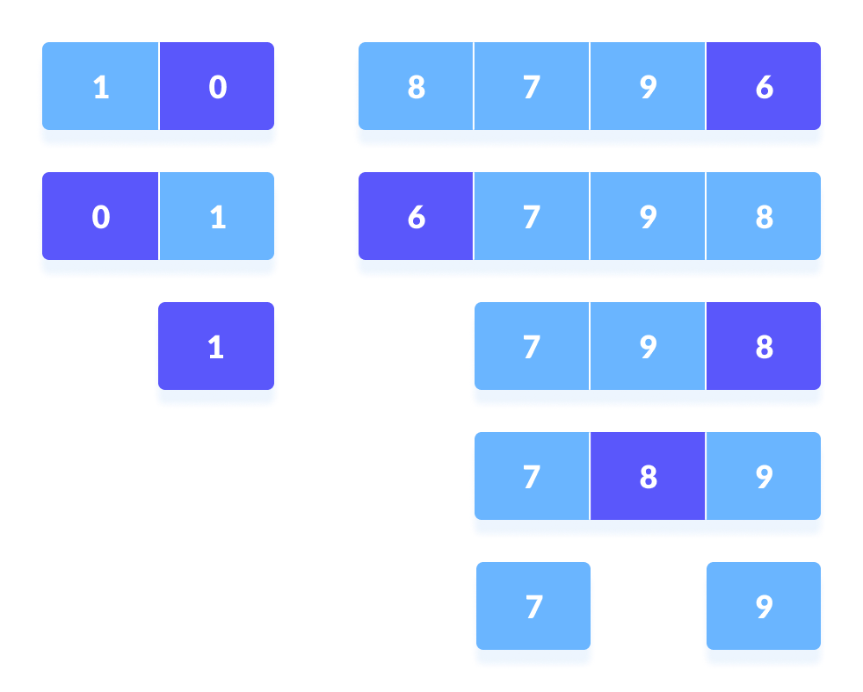
Contd…
Figure 5: Partitioning

Slide 36
Contd…
4. The sub-parts are again divided into smaller sub-parts until each subpart is formed of a single element.
5. At this point, the array is already sorted.

Slide 37
Picking Pivot Element
Like Merge sort, QuickSort is a Divide and Conquer algorithm. It picks an element as pivot and partitions the given array around the picked pivot. There are many different versions of quickSort that pick pivot in different ways.
Always pick first element as pivot.
Always pick last element as pivot (implemented below).
Pick a random element as pivot.
Pick median as pivot.

Slide 38
Decrease & Conquer
Reduce problem instance to smaller instance of the same problem
Solve smaller instance
Extend solution of smaller instance to obtain solution to original instance
Can be implemented either top-down or bottom-up
Also referred to as inductive or incremental approach

Slide 39
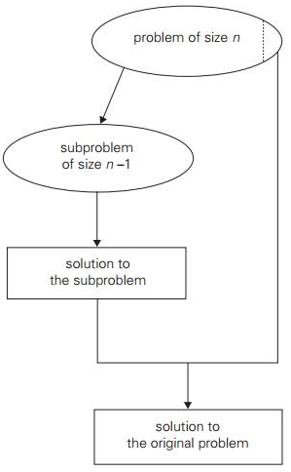
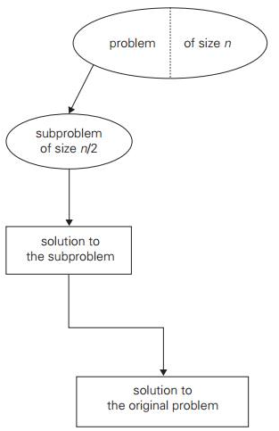
Decrease & Conquer (contd.)
Decrease by a constant (usually by 1):
  insertion sort
  graph traversal algorithms (DFS and BFS)
  topological sorting
  algorithms for generating permutations, subsets
Decrease by a constant factor (usually by half)
  binary search and bisection method
  exponentiation by squaring
  multiplication

Slide 40
Directed Acyclic Graph
A directed acyclic graph, i.e. a directed graph with no (directed) cycles.
a
b
a
b
c
d
c
d
a dag
Not a dag

Slide 41
Directed Acyclic Graph (contd.)
Arise in modeling many problems that involve prerequisite constraints (construction projects, document version control)
Vertices of a dag can be linearly ordered so that for every edge its starting vertex is listed before its ending vertex (topological sorting). Being a dag is also a necessary condition for topological sorting to be possible.

Slide 42
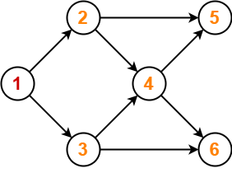
Topological Sorting
Topological sorting for Directed Acyclic Graph (DAG) is a linear ordering of vertices such that for every directed edge uv, vertex u comes before v in the ordering. Topological Sorting for a graph is not possible if the graph is not a DAG.
There can be more than one topological sorting for a graph. The first vertex in topological sorting is always a vertex with in-degree as 0 (a vertex with no incoming edges).
For this graph, following 4 different topological orderings are possible-
1 2 3 4 5 6
1 2 3 4 6 5
1 3 2 4 5 6
1 3 2 4 6 5

Slide 43
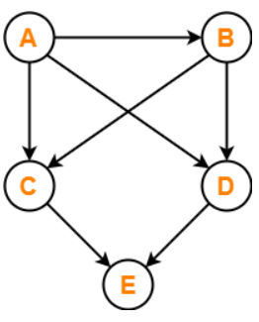
Topological Sorting Example (contd.)
Find the number of different topological orderings possible for the given graph-

Slide 44
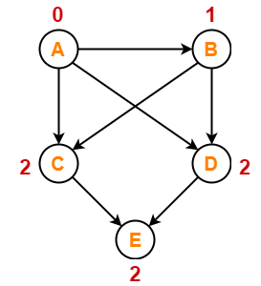
Topological Sorting Example (contd.)
Step-01:
Write in-degree of each vertex-

Slide 45
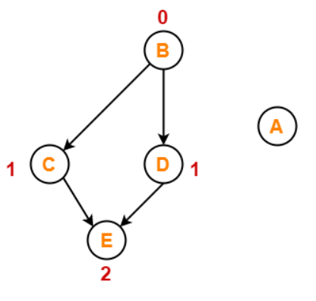
Topological Sorting Example (contd.)
Step-02:
Vertex-A has the least in-degree.
So, remove vertex-A and its associated edges.
Now, update the in-degree of other vertices.

Slide 46
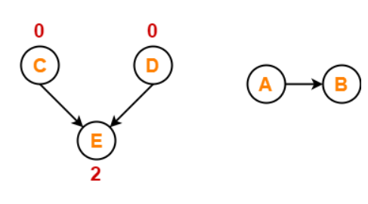
Topological Sorting Example (contd.)
Step-03:
Vertex-B has the least in-degree.
So, remove vertex-B and its associated edges.
Now, update the in-degree of other vertices.

Slide 47
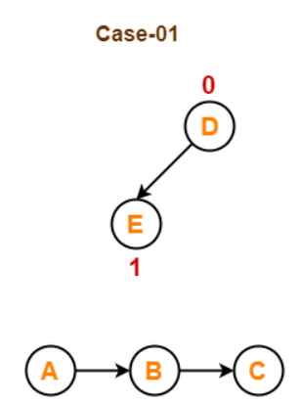
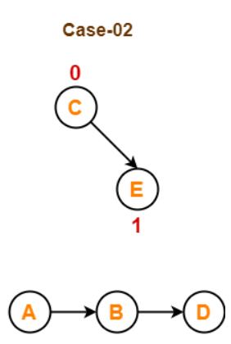
Topological Sorting Example (contd.)
Step-04:
There are two vertices with the least in-degree. So, following 2 cases are possible-
In case-01,
Remove vertex-C and its associated edges.
Then, update the in-degree of other vertices.
In case-02,
Remove vertex-D and its associated edges.
Then, update the in-degree of other vertices.

Slide 48


Topological Sorting Example (contd.)
Step-05:
Now, the above two cases are continued separately in the similar manner.
In case-01,
  Remove vertex-D since it has the least in-degree.
  Then, remove the remaining vertex-E.
In case-02,
Remove vertex-C since it has the least in-degree.
Then, remove the remaining vertex-E.

Slide 49
Topological Sorting Example (contd.)
For the given graph, following 2 different topological orderings are possible-
A B C D E
A B D C E

Slide 50
Algorithm of Topological Sorting
topoSort(u, visited, stack)
Input − The start vertex u, An array to keep track of which node is visited or not.
A stack to store nodes.
Output − Sorting the vertices in topological sequence in the stack.
Begin
mark u as visited
for all vertices v which is adjacent with u,
do
if v is not visited, then
topoSort (c, visited, stack)
done
push u into a stack End

Slide 51
Algorithm of Topological Sorting (contd.)
Perform Topological Sorting(Graph)
Input − The given directed acyclic graph.
Output − Sequence of nodes.
Begin
initially mark all nodes as unvisited
for all nodes v of the graph,
do
if v is not visited,then
topoSort(i, visited, stack)
done
pop and print all elements from the stack
End.

Slide 52
Application of Topological Sorting
Scheduling jobs from the given dependencies among jobs
Instruction Scheduling
Determining the order of compilation tasks to perform in makefiles
Data Serialization

Slide 53
1) https://www.tutorialspoint.com/data_structures_algorithms/divide_and_conquer.htm
2) Data Structures and Algorithms made easy By Narasimha Karumanchi.
3) The Algorithm Design Manual, 2nd Edition by Steven S Skiena
4) Fundamentals of Computer Algorithms - Horowitz and Sahani
References

Slide 54
THANK YOU
For any Queries-
E-Mail: gurpreetkaur.uic@cumail.in

